Slide 1
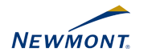
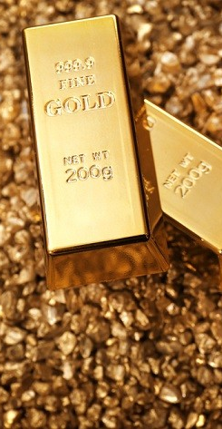
Newmont Mining
Recommendation: Buy
Price Target
$80-90
March 29th Price $73.13
Analyst Team
Daniel Marques
Company Information
Sector Industry Market Cap Sales
Beta
Materials
Precious Metal Mining 19.52B
7,300M
0.48
Price-Based Multiples
Ticker | Peers
24.58x | 24.58x
1.85x | 2.13x
28.26x | 34.12x
P/FCF
P/B
P/E
Selected Information
Operating Margin | 18.26%
Profit Margin | 0.10%
1 year Price Chart

Slide 2
Business Description
Business Description Industry Overview Competitors
Thesis Highlights:
Strategic Route Network
Long-Term Financial Performance
Poised for Future Success
Thesis Risks:
Market Competition
Economic Cyclicality
Valuation:
Comparable Analysis
Discounted Cash Flow
Football Field
Overview
Newmont Mining is a mining firm that produces gold and copper. Newmont focuses largely on gold production, as one of the largest gold miners in the world producing nearly 6 million ounces of gold yearly Newmont is one of the top 3 producers of gold in the world, with over 23,000 square miles of land to which Newmont holds the mineral rights. The company has operations in the US, Australia, Peru, Ghana, and Suriname, with Copper mines also in Australia and Phoenix, US. The company see most of its sales of gold at the London bullion spot market where the gold is used as an investment as well as a raw material for production of other goods. Newmont has recently acquired Goldcorp, another leader in the mining industry and a large producer of gold. Newmont and Goldcorp will join their operations and mining efforts in strategic locations as the firms sees beneficial. This acquisition creates one of the if not the largest long-term consistent producer of gold with a safe and diverse portfolio of mines, great reserves, and a very competitive debt-to-cash ratio.
Most of sales come from the sale of refined gold, however, the final product of the gold operations for this firm is generally doré bars. Doré is then sent to refineries to produce bullion which is then either accredited to the accounts of the firm or delivered to their clients. A portion of the gold is also sold in a concentrate that can contain other metals. Gold mining accounts for about 70% percent of the world supply of gold therefore there are different end users for the final product that the company sells. The two main uses of gold are for investing and fabrication through jewelry, electronics, especial coins, and gold bullion. For the last three years sales of gold have accounted for 96% of total sales of the firm, with production in four continents and five countries.
Recently Newmont has been a leader in acquisition and diversification, most recently with the acquisition of Goldcorp and the Nevada Joint Venture with Barrick Mining. This joint venture complex alone creates the third largest producer of gold with the only two firms ahead of it being Newmont and Barrick. This Joint Venture allows for Newmont to take advantage of synergies from combined operations in Nevada while staying away from Barrick’s risky portfolio. This joint venture is also low cost and longer profitable mines while still being able to merge with Goldcorp to grow their safe and long-term portfolio.
[2]
[1] 10-k
[2] Yahoo Finance

Slide 3
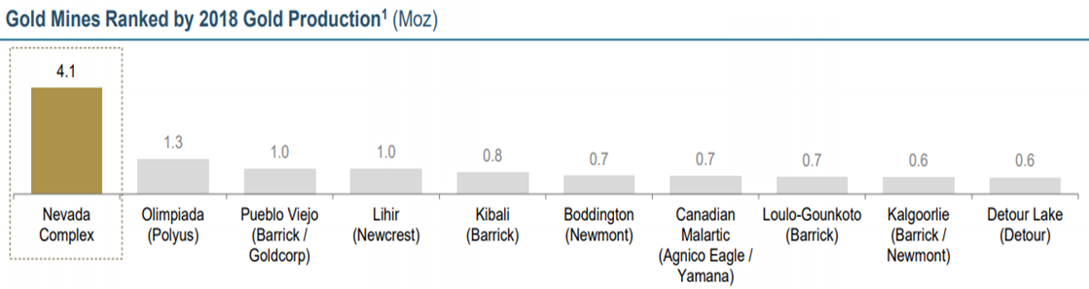
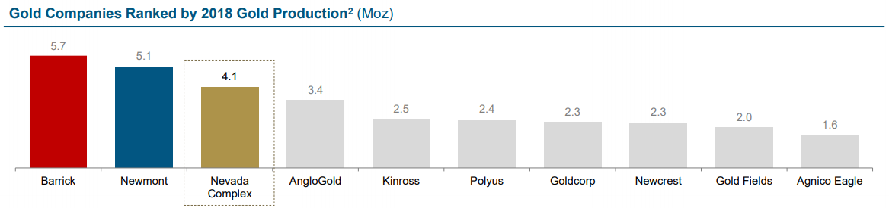
Business Description
Revenue Breakdown
Newmont Mining has mines in five different countries spread through four continents controlling 23,000 square miles of gold mines. With the Goldcorp merger the frim will combine operations in common locations, but the company can still expect to see a more diversified portfolio that Goldcorp brings after the divestments from the acquisition are completed. An important aspect in having a consistent and sustainable growing revenue in the gold mining industry is to have a diversified portfolio of mines that operate on different recovery and maintenance cycles to assure production is always at an optimal level through out all the mines.
Newmont mining has nearly doubled its adjusted net income since 2016 growing from $328 million to $692 million in 2018, which was slightly lower than 2017 due to portfolio improvements and impairments of exploration, especially, in North America. Their total gold production also decreased by nearly 3% because due to recoveries in some mines and lower leach tons in others. This decreased in revenue is what the company is trying to avoid growing forward by having a more diversified portfolio and focusing on keeping costs below competitors.
Despite Newmont’s recent decrease in revenue, Newmont is still one of the top producers in the world with outstanding margins compared to industry average. Newmont has $3.2 billion dollars in cash with only $0.9 billion in long-term debt. Newmont also has an industry leading sustaining cost per ounce of gold and a growing balanced reserve. Newmont has focused on strategy acquisitions focusing on improving synergies, with expect synergies saving of $265 million alone from Nevada Joint Venture, and even more synergies savings once the merger with Goldcorp is completed.
[2]
[2]
[1] 10-k
[2] NEM Financial Reports

Slide 4
Business Description Industry Overview Competitors
Thesis Highlights:
Strategic Route Network
Long-Term Financial Performance
Poised for Future Success
Thesis Risks:
Market Competition
Economic Cyclicality
Valuation:
Comparable Analysis
Discounted Cash Flow
Football Field
Industry Overview
Gold Mining Industry
The gold mining industry focuses on the mining and production of gold as a raw material that range in use from jewelry and special coins, to technology and gold bullion. For a large part goldminers focus on gold production with contracts in place to move that gold to refineries to be used for investment and fabrication as we mentioned. However, gold can also be sold as concentrate or raw material for other uses. Companies in the industry own the mines that they mine but some mines can be owned by multiple companies and organizations where synergies come into place. The industry has reached a mature level of growth as far as mines and projects go so firms have focused on consolidation and synergies to remain competitive. Aside from having to acquire the mines and materials to mine them, companies have to continuously focus on the life of their mines. Not only do companies have to worry about the cheapest and largest production levels for their mines they also have to take into account safety in their mines, resting cycles, production hold-ups, and life of the mine to create a consistent production year after year. Companies have to create a safe and diverse portfolio can allow them to operate at a consistent level of production regardless of any hold-ups or unexpected slow downs in any given project.
To stay competitive firms have to acquire other firms and other projects to take advantage of potential synergies. Synergies is the extra value that can be attained from joint forces of two or more firms when compared to their individual productions. This is largely important for miners because taking advantage of the right synergies can increase your production levels, lower costs, and increase the life of assets or mines. Companies like Newmont are industry leaders in taking advantages of synergies both through joint ventures and through mergers and acquisitions.
This industry is largely dominated by two firms, Barrick and Newmont, and due to a current consolidation period currently happening in the industry, these two companies are likely to grow stronger in the coming years. This creates a high barrier of entry due to large costs associated with acquiring the resources and materials needed as well as the condensates market share. Companies don’t have much direct competition considering the consolidation of the market, however, there are some areas where substitutes have replaced gold, but gold still remains largely irreplaceable due to the investing value associated with gold.
Catalysts and Drivers
The biggest catalyst in this industry is obviously gold prices, although companies try to hedge their prices and use reserves to level out the value of their product, the world economy plays a huge role in the fluctuation of gold prices. Metals are considered to be a cyclical industry so firms have to plan accordingly for their long-term productions and manage their reserves accordingly to maximize profits. Along with economic drivers, this industry also has significant government disruptions, especially lately, due to large mergers and environment and safety precautions. The mining industry overall has had some serious conflicts with safety and environmental impact which has affected the long-term regulations and requirements of the mines and safety of the workers and surrounding ecosystems. More recently, government approval has slowed down some mergers and acquisitions due to the large consolidations around the industry, however, frisk have been able to manage around the demands of the government and shareholders
[1] 10-K
[2] Bloomberg

Slide 5
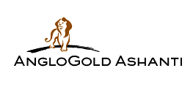
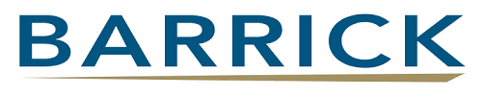
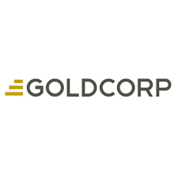
Business Description Industry Overview Competitors
Thesis Highlights:
Portfolio Improvement
Operations and Financials Leader
Synergies
Thesis Risks:
Reserves
Economic Cyclicality
Valuation:
Comparable Analysis
Discounted Cash Flow
Competitors
Firms
Barrick Mining
Barrick Mining is the largest mining gold mining firm in the world and Newmont’s biggest competitor. Barrick has tried to acquire Newmont multiple times before in the past and the two firms now have a joint venture in Nevada. Barrick produced 5.7 million ounces of gold last year compared to Newmont’s 5.1 million. Barrick and Newmont have been fierce rivals since the two firms drop all talks of merging back in 2012, since then Newmont’s shareholder value has outperformed that of Barrick by nearly 90%.
[1]
Goldcorp
Goldcorp is one of the largest producers of gold and has recently been acquired by Newmont and is awaiting approval to complete the acquisition. Goldcorp produced 3.1 million ounces of gold last fiscal year, however, the firm has largely been inefficient and underperforming when compared with competitors. This merger brings more value to Goldcorp shareholders than anyone else at the current proposal being considered.
AngloGold Ashanti
AngloGold is the third largest gold miner in the world, headquartered in South Africa with operations in over 10 countries. Although they are the third largest producer the gap in production between this firm and the top two firms (Barrick and Newmont) is large. AngloGold has had interest in other materials such as “nuclear fuels” however the firm has divested from other ventures to focus on gold production.
[1]
[1] Yahoo Finance

Slide 6
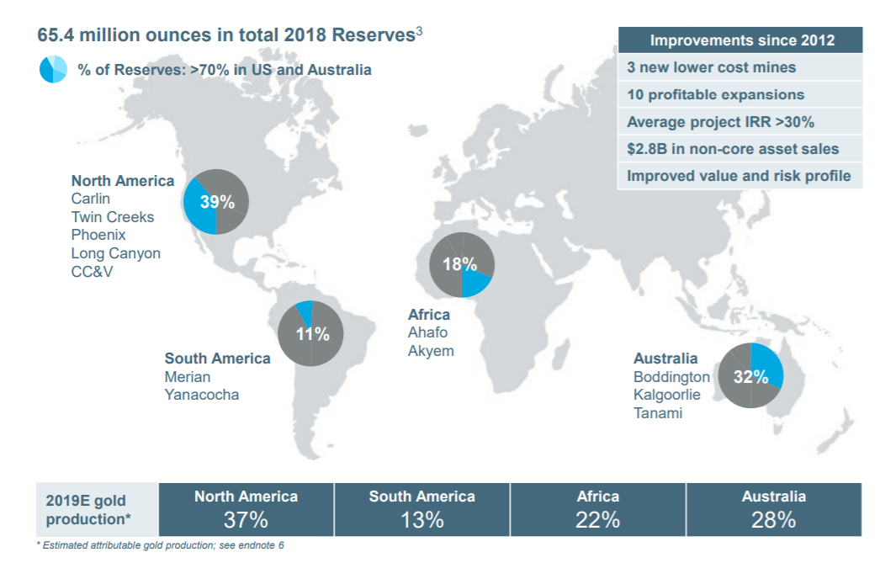
Business Description Industry Overview Competitors
Thesis Highlights:
Portfolio Improvement
Operations and Financials Leader
Synergies
Thesis Risks:
Reserves
Economic Cyclicality
Valuation:
Comparable Analysis
Discounted Cash Flow
Portfolio Improvement
Long-life Assets
Newmont has focused on developing a global portfolio of long-life assets to support the firms goals of consistent gold production for the future. Stable production with improving costs and mine life is the focus of Newmont’s global project pipeline.
Subika Underground, Africa : Commercial production was achieved in Q4 of 2018 with an expected goal production of 150,000 to 200,00 ounces of gold per year for the first five years and an initial mine life of over 10 years. This project adds higher grade but lower cost production at the Ahafo mine.
Ahafo Mill, Africa : This project improves production and accelerates stockpile processing, this project also capitalizes on the highly prospective resources in Ahafo.
Quecher Main, South America : This project is expected to reach commercial production in 2019, adding oxide production to Yanacocha, and expanding the life of Yanacocha for another 7 years with a sustainable production of 200,000 ounces annually for 5 years.
Newmont’s expansion and improvement projects are going better than expected with most projects finishing on time and within budget or even below budget for some projects. These projects help improve the life of mines about 7-12 years depending on the location as well as sustainable production to reach Newmont’s production goals of 6-7 million ounces of gold yearly. Most if not all projects completed or to be completed between 2017 and 2020 are already demonstrating Newmont’s production potential until 2025. Most importantly for Newmont, all new projects focus on improving safety and lowering risk both for employees and surroundings. Newmont is recognized as the leader in sustainability in the mining sector for 4 years with the lowest injury rates.
[1] 10-K

Slide 7
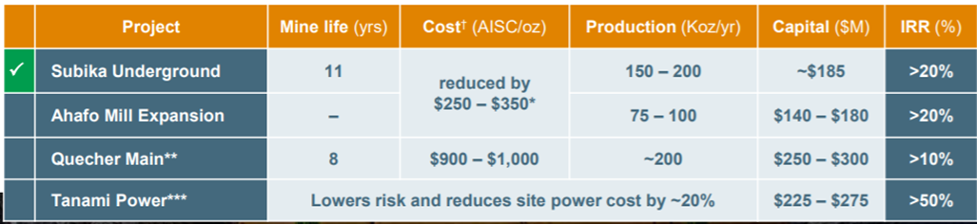
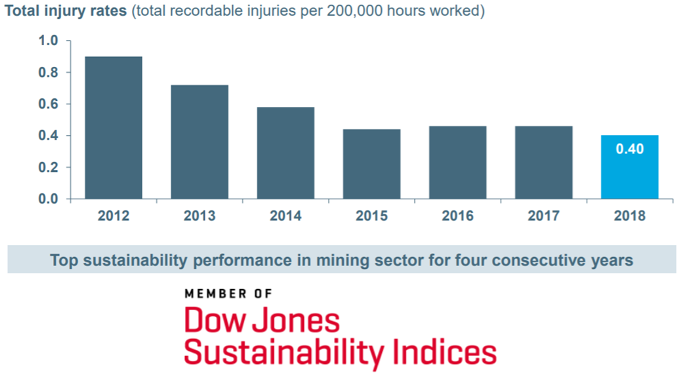
Business Description Industry Overview Competitors
Thesis Highlights:
Portfolio Improvement
Operations and Financial Leader
Synergies
Thesis Risks:
Reserves
Economic Cyclicality
Valuation:
Comparable Analysis
Discounted Cash Flow
Operations and Financial Leaders
Newmont has been a target of different mergers, acquisitions, and other collaborations within the industry for a very good reason. Newmont has focused on being an industry leader in creating lower cost production with targeted acquisition of new mines and mills that can add value and reduce and/or optimize costs of their current mines in different stages of their value chain depending on the location and the projects. Newmont deliver AISC of approximately $900/oz and produced 5.1Moz of gold in 2018. Newmont’s joint venture with Barrick on one of their largest mines as well as the Goldcorp acquisition will only further improve the full potential of their production and their cost cutting with expected synergies from their joint venture in Nevada of nearly $260 million. The acquisition of Goldcorp is going to add new assets that improve their global portfolio and takes advantage of synergies in various mines that Goldcorp and Newmont have. When analyze the financial performance of Newmont it is hard not to mention their cash and debt levels. Newmont finished 2018 with $3.4 billion in cash and only $900 million in debt, the balance sheet of an industry leader. They also declared a dividend of $0.56 dividend, a 124% increase from the previous year, and share buybacks returning nearly $400 million dollars to shareholders all together. This strong growth in dividends emphasizes the leaderships’ confidence in their future sustainability and predicted revenue growth.
Newmont is also a leader in operations and safety with consistent performance as the top sustainability performance for four years now with below average injury rates. It is important that mining companies focus on their sustainability and safety due to growing global tensions regarding the conditions and safety of mine workers following the collapse of a mine in Brazil. Being and industry leader in safety allows for them to reduce their break-down time due to injuries or safety conflicts.
[1] Annual Report
[2] Presentation to Shareholders (Investor Briefcase)

Slide 8
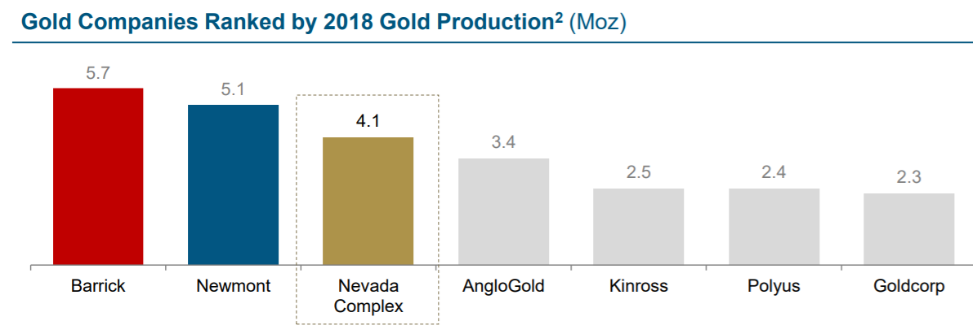
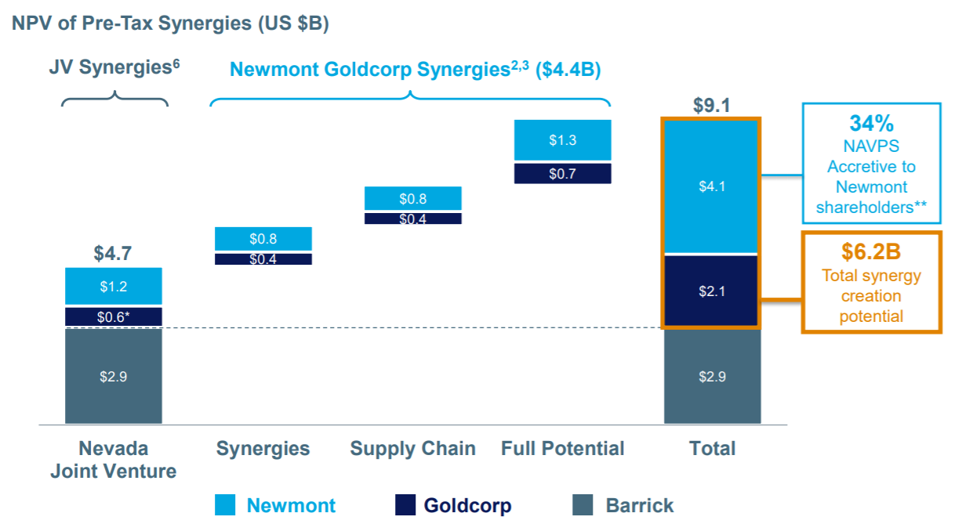
Business Description Industry Overview Competitors
Thesis Highlights:
Portfolio Improvement
Operations and Financials Leader
Synergies
Thesis Risks:
Reserves
Economic Cyclicality
Valuation:
Comparable Analysis
Discounted Cash Flow
Second Thesis Title
The future of Newmont Goldcorp
Newmont’s latest joint venture, the Nevada Joint Venture, brings together the worlds top gold producers, Newmont and Barrick, and combines one of their most profitable mines into one jointly operated mine with production levels that would put this JV as the third largest producer of gold in the world with the only two companies ahead of it being the owners of the this mine. The joint venture will be operated by Barrick which will further reduce the risk involved with this mine and it will improve profitability and production. Barrick predict Synergies savings of over $4.7 billion over the life of the mine with strong AISC of $775/oz. This joint venture also has ensured over 20 years of profitable and responsible mining which builds on Newmont’s focus of low cost long lived mines that create a virtuous cycle of value creation. The best part of this Joint Venture is how most of these optimizations will take into effect immediately such as supply chain costs, warehouse and transportation, and other aspects of production and management.
This joint venture is only the begging for Newmont who is under negotiation to finalize the acquisition of Goldcorp to form Newmont Goldcorp, the world’s largest producer of gold. The new Newmont Goldcorp’s value proposition would bring them over $4.4 billion in pre-tax synergies in supply chain efficiencies and improvements. This puts Newmont at over $6.2 billion in synergies created throughout their mergers and joint ventures and “$4.1B of additional value created for Newmont shareholders.” Lastly this merger along with the Nevada joint venture give Newmont the strongest portfolio of operating mines and reserves in favorable jurisdictions.
[1] Presentation to Shareholders (Investor Briefcase)

Slide 9
Business Description Industry Overview Competitors
Thesis Highlights:
Portfolio Improvement
Operations and Financials Leader
Synergies
Thesis Risks:
Reserves
Economic Cyclicality
Valuation:
Comparable Analysis
Discounted Cash Flow
Risks
Depleted Reserves
For Newmont Mining as well as other companies in the industry, reserves are an important part of operations to help maintain steady supply and production. As reserves get depleted companies have to go through exploratory methods to find new reserves. These tend to be highly unsuccessful and current and future explorations may end not producing any new mineral producing operations therefore they are a big risk for the company. These research operations can take many years to be identified and even longer to reach commercial production, along with high costs, this strategy is not the most favorable for firms such as Newmont. Another way to replace or grow reserves is by acquiring other mines and assets from other competitor in the industry but even these acquisitions can be complicated because of the factors Newmont analysis for their typical acquisition including: “historical operating results, estimates of and assumptions regarding the extent of ore reserves, the timing of production from such reserves and cash and other operating costs.” With such inconsistencies and lack of certainty for the future, Newmont has to go above and beyond to assure their reserves are not depleted without replacements. Newmont is still years away from having depleted reserves however they have been doing well in acquiring and merging operations with different firms to increase their reserves and long term production. Also, Newmont as the best cash and access to leverage to acquire the reserves and mines it best sees fit for their future production, putting them ahead of competition.
[1] 10-K

Slide 10
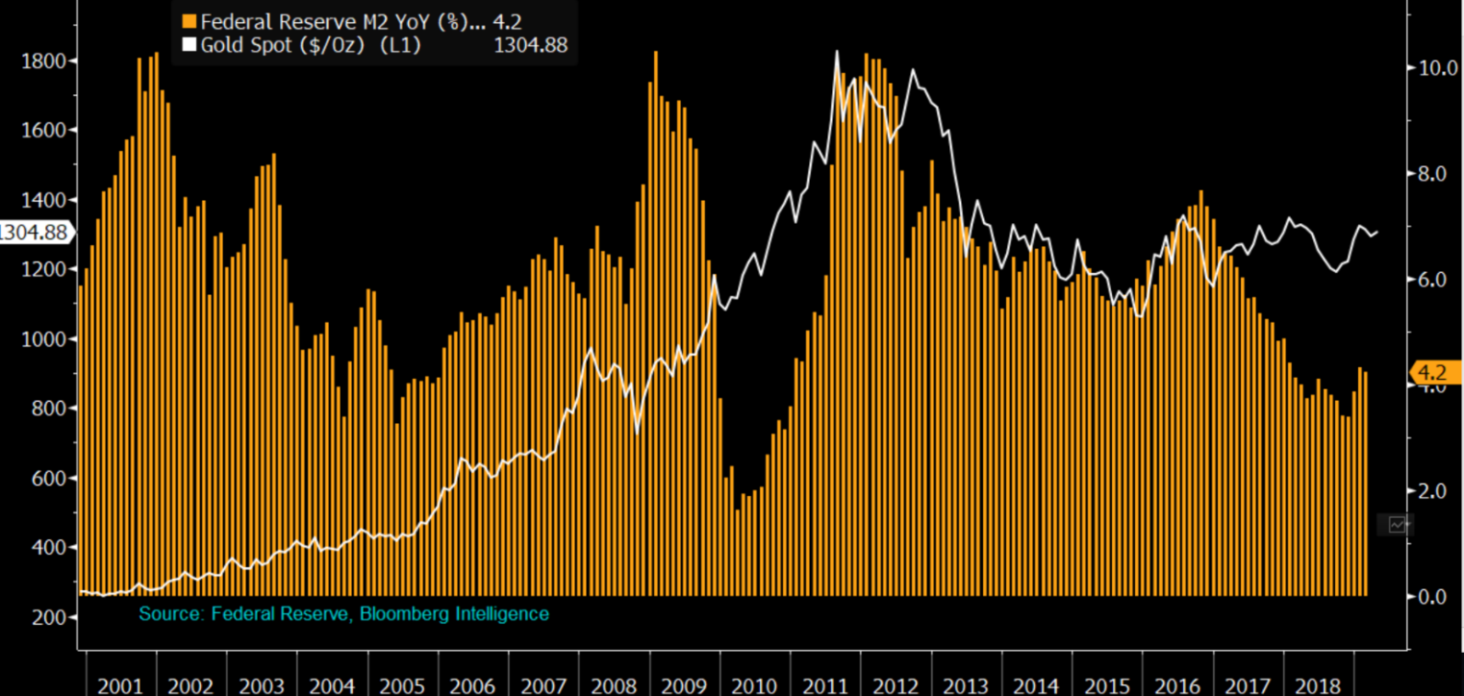
Business Description Industry Overview Competitors
Thesis Highlights:
Portfolio Improvement
Operations and Financials Leader
Synergies
Thesis Risks:
Reserves
Economic Cyclicality
Valuation:
Comparable Analysis
Discounted Cash Flow
Risks
Economic Cyclicality
The gold mining industry is very volatile in their profitability due to the fluctuation of the gold and copper prices which affects profitability. Newmont considers the following factors to influence prices:
Gold sales, purchases or leasing by governments and central banks;
Speculative short positions taken by significant investors or traders in gold or copper:
The relative strength of the U.S. dollar
The monetary policies employed by the world’s major Central Banks
The fiscal policies employed by the world’s major industrialized economies
Expectations of the future rate of inflation;
Interest rates
Recession or reduced economic activity in the United States, China, India and other industrialized or developing countries
Increased import and export taxes
Hedging and below average costs of production have helped Newmont stay profitable and competitive over the years, however, it is consistently harder to predict how governmental restrictions such as taxes tariffs and spending are going to affect demand, especially in China. China has consistently had the largest demand of gold, however, it has been very irregular and hard to predict which makes it harder for firms like Newmont to plan accordingly for future demand and supply and leveling reserves to increase profitability and control price levels to a certain extent.
Although this affects immediate profitability and supply, long term gold prices are still considered to be at its cheapest level based on the US money supply which is expected to go even cheaper as US spending and money supply are increasing rapidly.
[1] 10-K
[2] Bloomberg

Slide 11
Business Description Industry Overview Competitors
Thesis Highlights:
Portfolio Improvement
Operations and Financials Leader
Synergies
Thesis Risks:
Reserves
Economic Cyclicality
Valuation:
Comparable Analysis
Discounted Cash Flow
Comparable Analysis
In our Comparable Analysis, we analyzed Newmont Mining’s Equity Value and Enterprise value as well as EV/EBITDA and P/E multiples against comparable companies from the gold mining industry. The comparable companies include Barrick Gold, Newcrest Mining, Royal Gold, and AngloGold Ashanti. Our comparable analysis shows a premium of 18% and 14% for Newmont Mining versus the median of its competitors in EV/EBITDA and P/E ratios respectively.
Below, you will see a comparable analysis of Newmont Mining’s Revenue, EBITDA, and Net Income versus its competitors mentioned above. The chart below reflects the date for the last twelve months and a forecast for the following year. Newmont’s Revenue and Net Income, for both years, surpass the maximum of the competitors. Net Income for Newmont Mining has a premium of 3% and 2%, for the last twelve months and forecasted year 1 respectively, against the maximum of the four competitors including Barrick Gold.
 | Equity Value | Enterprise Value | EV/ EBITDA | P/E LTM | P/E FY01 | P/E FY02
Maximum | $ 14,987.7 | $ 22,297.7 | 20.3 x | 44.1 x | 57.3 x | 41.9 x
75th Percentile | 13,955.7 | 17,990.5 | 13.2 x | 26.4 x | 32.3 x | 24.9 x
Median | $ 9,648.6 | $ 12,094.3 | 9.1 x | 20.2 x | 22.8 x | 18.8 x
25th Percentile | 5,577.8 | 7,256.7 | 7.2 x | 18.0 x | 19.4 x | 16.4 x
Minimum | 5,254.8 | 6,125.2 | 6.7 x | 11.9 x | 12.7 x | 10.5 x
Newmont Mining | $ 17,414 | $ 24,854 | 10.7 x | 23.0 x | 24.6 x | 20.2 x
 | Revenue LTM | Revenue FY01 | EBITDA LTM | EBITDA FY01 | Net Income LTM | Net Income FY01
Maximum | $ 7,240.0 | $ 8,388.1 | $ 3,050.0 | $ 3,422.7 | $ 731.2 | $ 691.6
75th Percentile | 4,765.0 | 5,180.7 | 1,910.0 | 2,115.3 | 693.9 | 599.1
Median | $ 3,760.0 | $ 3,929.4 | $ 1,335.0 | $ 1,624.5 | $ 560.6 | $ 490.2
25th Percentile | 2,792.3 | 2,922.1 | 930.6 | 1,257.3 | 362.1 | 334.0
Minimum | 429.0 | 446.6 | 302.3 | 321.1 | 129.0 | 99.3
Newmont Mining | $ 7,253.0 | $ 8,440.0 | $ 2,315.0 | $ 3,065.8 | $ 756.3 | $ 708.1
[1] Valuation Model
[2] Bloomberg

Slide 12
Business Description Industry Overview Competitors
Thesis Highlights:
Portfolio Improvement
Operations and Financials Leader
Synergies
Thesis Risks:
Reserves
Economic Cyclicality
Valuation:
Comparable Analysis
Discounted Cash Flow
Discounted Cash Flow
Due to the pending (now completed) merger between Newmont Mining and Goldcorp, our DCF model was structured differently to measure the value of Newmont Mining based on current production levels and depletion levels of current proven and probable reserves to predict a stable level of production and sales for the life of the current proven and probable reserves. At current production levels the proven and probable reserves would be depleted for a most of the regions, because of Newmont’s leadership strategy to divest higher cost mines we assumed that these mines would be divested soon after year 9, therefore we project our DCF model for 9 years to not include any costs associated with closing of depleted mines.
Because the prices of gold are cyclical, we modeled our projections based on three different gold prices, high, average, and low as seen in Newmont’s 10-k. Our DCF Model shows that over the 9 year period Newmont’s reserves can out perform the S&P 500 against all three different circumstances, however, this valuation does not take into account all the savings, such as $365 million a year in pre-tax synergies, production level improvement to 6-7 million ounces of gold annually, increase reserves, and other benefits of the Goldcorp acquisition. It is important to know that revenue and share price are likely to move according with gold prices which our valuation does not reflect because it uses an average of given historical data and forecasted growth. The chart below shows affect of the cyclicality of gold on revenue and EBITDA, this highlights how when gold is forecasted to do well, as it is for the next two years, revenue will increase, however, as gold prices go lower, so will revenue.
(Based on High Gold/Copper Prices) | 2018 Actual | 2019 Forecasted | 2020 Forecasted | 2021 Forecasted | 2022 Forecasted
Revenue (000's) | $ 7,253,000.00 | $ 7,464,428.14 | $ 8,079,780.69 | $ 7,483,662.89 | $ 6,360,415.00
COGS (000's) | $ 4,093,000.00 | $ 4,006,330.06 | $ 4,152,003.20 | $ 3,670,700.13 | $ 2,951,560.09
Operating Expense | $ 845,000.00 | $ 827,106.99 | $ 857,181.21 | $ 714,316.69 | $ 601,751.16
EBITDA | $ 2,315,000.00 | $ 2,630,991.09 | $ 3,070,596.27 | $ 3,098,646.07 | $ 2,807,103.74
[1] Valuation Model
[2] Bloomberg

